Slide 1
text structure

Slide 2
What is text structure?
Text structure is how information is organized in a passage
The structure can change multiple (many) times in a passage

Slide 3
Types of Text Structure
There are eight (8) common types of text structure:
Cause and Effect
Chronological Order
Compare and Contrast
Order of Importance
Problem and Solution
Sequence/Process
Spatial/Descriptive
Definition

Slide 4
Cause and Effect
The results of something are explained.
What is a cause?
Something that gives rise to an action
What is an effect?
A result of an action

Slide 5
Cause and Effect
With a partner create a list of cause and effect signal words.
Be prepared to share with the class.

Slide 6
Signal words for cause/effect:
Because, since, consequently, this led to…so, if…then, nevertheless, accordingly, because of, as a result of, in order to, may be due to, yet, for this reason, not only…but, also, due to, on account of, resulting

Slide 7
Cause and Effect
With your neighbor, identify the cause and effect in the passage.
You have 45 seconds.
Becky Smith was invited to go to see “Breaking Dawn” with a group of her friends. Becky’s mom told her she could see the movie, but only if she cleaned her room and washed the dishes. Becky was so focused on picking out the perfect outfit that she forgot about her mom’s rule. Because Becky did not do her chores, she was not allowed to go the movie.

Slide 8
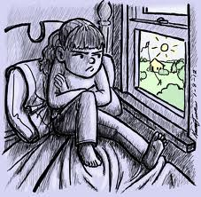
Cause and Effect
Cause
Becky did not do her chores.
Effect
Becky was not allowed to go to the movie.

Slide 9
Chronological Order
Information is organized in order of time.
With a your neighbor, create a list of signal words.

Slide 10
Chronological Order/Sequence Signal Words:
First, second…, not long after, next, then, initially, before, after, finally, following this, in the process of

Slide 11
Chronological Order
Jack and Jill ran up the hill to fetch a pail of water. Jack fell down and broke his crown and Jill came tumbling after.

Slide 12
Compare and Contrast
Two or more things are described
Their similarities and differences are discussed/analyzed.

Slide 13
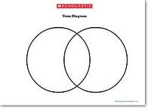
Compare and Contrast
Using a Venn Diagram (illustrated below), you will have 3 minutes to identify the similarities and differences of something.
You will only be using facts—not opinions!

Slide 14
Compare and Contrast
Write brief paragraph that explains the similarities and differences in your Venn Diagram.
Highlight/underline your signal words
Be ready to share.

Slide 15
Compare and Contrast Signal Words
Different from, same as, similar to, similarly, as opposed to, instead of, however, compared to/with, as well as, either…or, but, on the other hand, on the same token, likewise, on the contrary

Slide 16
Order of Importance
Information is expressed as a hierarchy or in priority
Either least important to most important or vice versa (Most important to least)

Slide 17
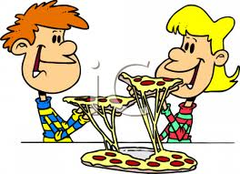
Order of Importance
Create a paragraph in which you describe the least and most horrible things you could do on a date.
Highlight your signal words
You have 5 minutes.
Be prepared to share your ideas.

Slide 18
Order of Importance
Here are the three worst things that you can do on a date. First, you could tell jokes that aren’t funny and laugh really hard to yourself. This will make you look bad. Worse though, you could anger your date. One bad “joke” may cause your date to yell at you, thus ruining the evening. But the worst thing that you can do is to appear slovenly. By not showering and properly grooming, you may disgust your date, and this is the worst thing that you can do.

Slide 19
Order of Importance
What are the least and worst things you could do on a date?
Least:
Tell really bad jokes.
Worst:
Don’t shower before the date.

Slide 20
Signal Words:
Central, principal, chief, major, main, key, primarily, significant, finally, lastly, most important

Slide 21
Problem and Solution
A problem is described and a response or solution is proposed or explained.

Slide 22
Problem and Solution
Read the following passage.
Identify the problem and solution with your neighbor.
Write down your answers on a scrap piece of paper.
You will have 2 and a half minutes.

Slide 23
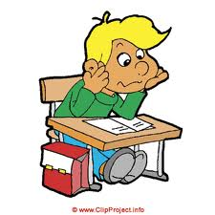
Problem and Solution
The volume in the hallway after lunch is an increasing problem. Loud students in the hallway disrupt the learning of those in class. Therefore, the teachers should enact a silent hallway policy to protect the learning of all students.

Slide 24
Problem and Solution
What’s the problem?
Students are too loud in the hallways.
What’s the solution?
Teachers should enact a silent hallway policy.

Slide 25
Problem/Solution Signal Words
Problem, the question, is, a solution, one answer is, need, difficulty, dilemma, challenge, issue, answer, propose, suggest, indicate, solve, resolve, plan

Slide 26
Sequence/Process
Information is organized in steps.
A process is explained.

Slide 27
Sequence/Process
Take out a piece of paper for this activity.
Activity:
Marvin the Martian has just landed in Houston, TX. Marvin is rather hungry and really wants to eat a bowl of cereal with milk, but he doesn’t know how! Write out each step Marvin must take to properly prepare and eat a bowl of cereal. Underline or highlight your signal words.
*You will have 2 minutes to write out these steps!
Be prepared to share your answers.

Slide 28
Sequence/Process
Get a clean bowl from the cabinet.
Take out a clean spoon from the utensil drawer.
Pick the cereal you want.
Retrieve the milk from the refrigerator.
Pour the cereal into the bowl, but don’t fill it up all the way!
Pour the milk into the cereal, but don’t pour too much!
Use the spoon to scoop out the cereal and milk and bring it to your mouth.
Chew, swallow, repeat until the cereal is gone!

Slide 29
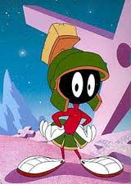
Sequence/Process
Thank you, earthlings!

Slide 30
Sequence/Process Signal Words
First, second…, not long after, next, then, initially, before, after, finally, following this, in the process of

Slide 31
Spatial/Descriptive
Information is organized in order of space (top to bottom, left to right).
Example:
When you walk into my living room, my sofa and a bookcase is to your right. To your left are the stairs leading to the second floor. The second bookcase is directly in front of you. On top of the second bookcase is my navy teddy bear.

Slide 32
Spatial/Descriptive
Now it’s your turn!
Using spatial (space) clues, write a description of a place that you like to be. Highlight or underline your signal words
Be prepared to share your responses.
You have 2 minutes to complete your descriptions.

Slide 33
Spatial/Descriptive Signal Words
Behind, next to, diagonally, horizontal, in front of, to the left/right of, for instance, for example, such as, to illustrate, most important, in addition, another, furthermore, also, to begin with.

Slide 34
Definition
It is used to introduce, explain, and describe a word or concept. It has three parts—a term, a definition, and an example.
Signal Words: Defined as, is, known, is used to mean, for example, to illustrate, for instance, such as

Slide 35
Closure
With a neighbor, answer the following questions:
What is text structure?
What are the seven types?
Pick two to explain to your neighbor.
Which is the most challenging structure for you?
*You will have 3 minutes.
*Be prepared to share your answers!

