Slide 2
Beyond Assessment: Delivering Opportunity
Less than half of the students who take the SAT® are college ready.
Notes:
In March, the College Board announced revisions to the SAT and other programs as part of a larger solution that is aimed at delivering more opportunities to more students so that they are prepared to succeed in college and in career.
The revised SAT will launch in spring 2016, after the a revised PSAT/NMSQT which will launch in the fall of 2015.
The SAT will be offered in print and, at selected locations, on computer.

Slide 3
Beyond Assessment: Delivering Opportunity
Entering College Students
>30%
Require remediation
Public 4-Year Institution Remediation Rate
26.3%
Public 2-Year Institution Remediation Rate
40.8%

Slide 4
Beyond Assessment: Delivering Opportunity
Notes:
Propel students into opportunities they have earned
The College Board and its members are committed to actions that propel students into opportunity. Our Access to Opportunity initiatives build on assessment results and are based on current research that shows measurable outcomes for students. This work will be ongoing and iterative as we identify, implement, and bring to scale initiatives to help students most effectively move forward in their education.
College Application Fee Waivers
Every income-eligible student who takes the SAT will receive four fee waivers to apply to college. This initiative is possible thanks to the generosity and trust of both member and nonmember colleges. It builds on Apply to 4 or More™ and Realize Your College Potential, two recent College Board initiatives to provide college-ready, low-income students with customized, targeted support for the college application process.
All In
The College Board’s All In campaign aims to ensure that every African American, Latino, and Native American student who is ready for rigorous work takes an AP course or another advanced course. These students are identified through AP PotentialTM. The All In campaign will also extend to rural students with limited access, as well as to girls with potential in disciplines in which they are underrepresented (such as computer science).
College Application Fee Waivers
Every income-eligible student who takes the SAT will receive four fee waivers to apply to college. This initiative is possible thanks to the generosity and trust of both member and nonmember colleges. It builds on Apply to 4 or More™ and Realize Your College Potential, two recent College Board initiatives to provide college-ready, low-income students with customized, targeted support for the college application process.
Protect opportunity from pressures of inequality
The road to college success has always been excellent work in the classroom. But the rise of costly test preparation has introduced a level of inequality among students. With the redesign of the SAT, the College Board is announcing its commitment to providing free, high-quality test-preparation materials for all.
Clear and Open SAT
More than ever, we are linking the SAT to the best of classroom learning. When students engage in rigorous course work, they give themselves the best chance to succeed — not just on the SAT, but in college and career. As test day approaches, students can use our free test-preparation resources to engage in focused review and authentic practice.
Partnership with Khan Academy
We are happy to announce that we have partnered with Khan Academy to provide free test-preparation programs and resources that will be available to all students. In our partnership with Khan Academy, we will continually work together to ensure that the practice materials are of the highest quality and truly focus on the work that matters most. And we will train tutors, counselors, mentors, and others to help students take full advantage of these resources.
Promote excellent classroom work and support students who are behind
Current research shows us that students need to dig deeper into fewer topics — those topics that are most important for success in college and career. When we help students focus on the skills and knowledge that are essential for college readiness, we’re setting them up to succeed. We will work with classroom teachers to ensure that the daily work students do in grades 6–12 aligns with the demands of college and career readiness.
Research also shows that students who are behind by the time they enter high school rarely catch up without focused support. We must also do more to accelerate these students forward by focusing on their individual academic needs as well as on noncognitive factors like motivation, grit, and resilience.
Instruction Modules for Grades 6-12
The College Board will collaborate with teachers and college faculty to design instructional resources for use in grades 6–12 to help students focus on the work that matters most. We will also continue to reach out to students who are falling behind and help them accelerate so they can get back on track.
We will promote analytical writing throughout our assessments and instructional resources. We will work with teachers to weave it throughout course work in English, science, history and social studies, and the arts. To underscore the importance of this skill area, we will sponsor a set of prizes for the best student analytical writing, with the winning entries to be published in The Atlantic.
Personalized Online Guidance
The College Board will expand supports to students who are falling behind and help them accelerate so they can get back on track. These supports will include individualized diagnostic tools and targeted resources to focus on where students most need help. We will also invest in tools to evaluate and support students’ noncognitive skills that can accelerate their learning.

Slide 5
Goals of the Redesigned SAT
More focused on the few essential things that research shows matter most for college readiness
Assessment and instruction will work together
Open and clear, so students and educators know what to expect
Notes:
The redesigned SAT will ask students to apply a deep understanding of the few skills and content areas most important for college and career readiness. The questions will be more familiar to students because they’ll be modeled on the work of the best classroom teachers. And the College Board will be open and clear, taking the mystery out of the exam and providing the full SAT test specifications and sample items well in advance of the first administration in spring 2016. Free test preparation is also on the way.

Slide 6
About the Redesigned SAT
*Please note: All time limits are tentative and subject to research.
Notes:
About the Redesigned SAT
There will be three sections: Evidence-Based Reading and Writing, Math, and the Essay.
The length of the SAT will be about three hours, with an added 50 minutes for the essay. Precise timing will be finalized after further research.
Score Highlights
The SAT will have a 400- to 1600-point score scale.
The Evidence-Based Reading and Writing section and the Math section will each be scored on a 200- to 800-point scale.
Scores for the Essay section will be reported separately.
The redesigned exam will give credit for every correct response but will not deduct points for incorrect answers (rights-only scoring).
Rich score reports will provide a more detailed view of student achievement in specific skills.

Slide 7
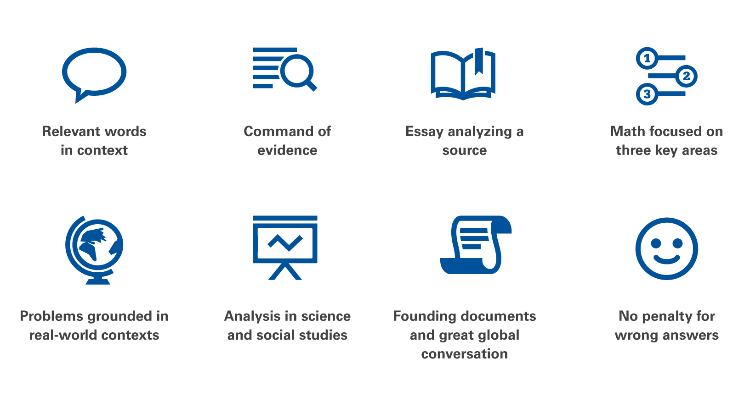
8 Key Changes to the SAT
Notes:
The redesigned SAT will ask students to apply a deep understanding of the few things shown by current research to matter most for college readiness and success. They’ll find questions modeled on the work of the best classroom teachers and perform tasks practiced in rigorous course work. The SAT redesign is centered on eight key changes.
Relevant Words in Context
The redesigned SAT will focus on relevant words, the meanings of which depend on how they’re used. Students will be asked to interpret the meaning of words based on the context of the passage in which they appear. This is demanding but rewarding work. These are words that students will use throughout their lives — in high school, college, and beyond.
Requiring students to master relevant vocabulary will change the way they prepare for the exam. No longer will students use flashcards to memorize obscure words, only to forget them the minute they put their test pencils down. The redesigned SAT will engage students in close reading and honor the best work of the classroom.
Command of Evidence
When students take the Evidence-Based Reading and Writing section of the redesigned SAT, they’ll be asked to demonstrate their ability to interpret, synthesize, and use evidence found in a wide range of sources. These include informational graphics and multiparagraph passages excerpted from literature and literary nonfiction; texts in the humanities, science, history, and social studies; and career-related sources.
For every passage students read, there will be at least one question asking them to select a quote from the text that best supports the answer they have chosen in response to the preceding question. Some passages will be paired with informational graphics, and students will be asked to integrate the information conveyed through each in order to find the best answer.
Questions that assess writing skills will also depend on a command of evidence. Students will be asked to analyze sequences of paragraphs to make sure they are correct, grammatically and substantively. In some questions, students will be asked to interpret graphics and edit the accompanying passages so that they accurately convey the information in the graphics.
The redesigned SAT will more closely reflect the real work of college and career, where a flexible command of evidence — whether found in text or graphic — is more important than ever.
Essay Analyzing a Source
The focus of the Essay section on the redesigned SAT will be very different from the essay on the current SAT. Students will read a passage and explain how the author builds an argument. They’ll need to support their claims with evidence from the passage. This task more closely mirrors college writing assignments.
The new Essay section is designed to support high school students and teachers as they cultivate close reading, careful analysis, and clear writing. It will promote the practice of reading a wide variety of arguments and analyzing how authors do their work as writers.
The essay prompt will be shared in advance and remain consistent. Only the source material (passage) will change. The Essay will be an optional component of the SAT, although some school districts and colleges will require it.
Math Focused on Three Key Areas
The exam will focus in depth on three essential areas of math: Problem Solving and Data Analysis, the Heart of Algebra, and Passport to Advanced Math. Problem Solving and Data Analysis is about being quantitatively literate. It includes using ratios, percentages, and proportional reasoning to solve problems in science, social science, and career contexts. The Heart of Algebra focuses on the mastery of linear equations and systems, which helps students develop key powers of abstraction. Passport to Advanced Math focuses on the student’s familiarity with more complex equations and the manipulation they require.
Current research shows that these areas most contribute to readiness for college and career training. They’re used disproportionately in a wide range of majors and careers. The SAT will sample from additional topics in math, but keep a strong focus on these three.
Problems Grounded in Real-World Contexts
Throughout the redesigned SAT, students will engage with questions grounded in the real world, questions directly related to the work performed in college and career.
In the Evidence-Based Reading and Writing section, reading questions will include literature and literary nonfiction, but also feature charts, graphs, and passages like the ones students are likely to encounter in science, social science, and other majors and careers. Students will be asked to do more than correct errors; they’ll edit and revise to improve texts from the humanities, history, social science, and career contexts.
The Math section will feature multistep applications to solve problems in science, social science, career scenarios, and other real-life contexts. Students will be presented with a scenario and then asked several questions about it. This allows students to dig into a situation and think about it, then model it mathematically.
Analysis in Science and in Social Studies
When students take the redesigned SAT, they will be asked to apply their reading, writing, language, and math skills to answer questions in science, history, and social studies contexts. They will use these skills — in college, in their jobs, and in their lives — to make sense of recent discoveries, political developments, global events, and health and environmental issues.
Students will encounter challenging texts and informational graphics that pertain to issues and topics like these in the Evidence-Based Reading and Writing section and the Math section. Questions will require them to read and comprehend texts, revise texts to be consistent with data presented in graphics, synthesize information presented through texts and graphics, and solve problems based in science and social science.
Founding Documents and Great Global Conversation
America’s founding documents — such as the Declaration of Independence, the Constitution, and the Bill of Rights — are all rather short, but they have inspired a conversation that endures today. Every time students take the redesigned SAT, they will encounter an excerpt from one of the Founding Documents or a text from the ongoing Great Global Conversation about freedom, justice, and human dignity. In this way, we hope that the redesigned SAT will inspire deep engagement with texts that matter and reflect not only what is important for college and career, but what is important for citizenship here and around the world.
No Penalty for Wrong Answers
The redesigned SAT will remove the penalty for wrong answers. Students will earn points for the questions they answer correctly. This move to rights-only scoring encourages students to give the best answer they have to every problem.

Slide 8
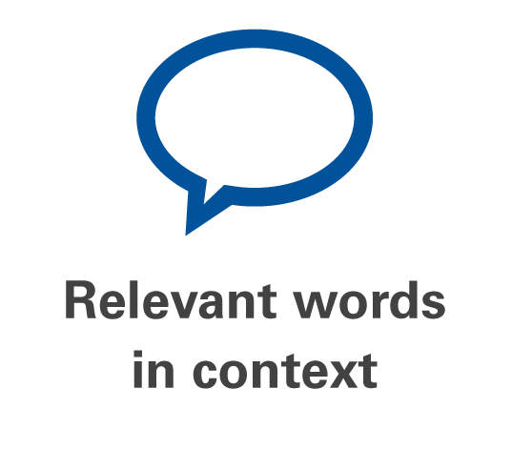
8 Key Changes to the SAT
Students will need to:
Interpret meaning based on context
Master relevant vocabulary
Engage in close reading
Notes:
Relevant Words in Context
The redesigned SAT will focus on relevant words, the meanings of which depend on how they’re used. Students will be asked to interpret the meaning of words based on the context of the passage in which they appear. This is demanding but rewarding work. These are words that students will use throughout their lives — in high school, college, and beyond.
Requiring students to master relevant vocabulary will change the way they prepare for the exam. No longer will students use flashcards to memorize obscure words, only to forget them the minute they put their test pencils down. The redesigned SAT will engage students in close reading and honor the best work of the classroom.

Slide 9
Current SAT Example: Sentence Completions
Some fans feel that sports events are _____ only when
the competitors are of equal ability, making the outcome of the game ________.
(A) successful . . assured
(B) boring . . questionable
(C) dull . . foreseen
(D) interesting . . predictable
(E) exciting . . uncertain
Notes:
Single sentence with no other context.

Slide 10
Redesigned SAT Sample Item: Relevant Words in Context (Writing & Language Test)
Notes:
Entire passage not shown on the slide
Question appears as part of a larger passage, not one single sentence.
In this sort of question, students must demonstrate not only facility with language in general but also skill in using language in particular contexts to convey meaning clearly and precisely.
This question asks students to determine which word makes the most sense in the context of a sentence from a passage about painter Dong Kingman. The best answer here is choice C because “departed” is the most
contextually appropriate way to indicate that Kingman had deviated from the tradition of Chinese landscape painting in a number of ways.

Slide 11
Current SAT Example: Identifying Sentence Errors
The students have discovered that they can address issues
A B
more effectively through letter-writing campaigns and not
C D
through public demonstrations. No error
E
Notes:
Single sentence, not part of a larger passage
Asks the student to identify the error, but does not ask student for improvement of sentence

Slide 12
Redesigned SAT Sample Item: Relevant Words in Context (Writing & Language Test)
Notes:
Entire passage not shown on this slide
This question asks students to determine the most economical way to express an idea clearly.
The sentence in question appears within the context of a larger passage.
**Note: “relevant words in context” does not always refer to testing of one particular word. In this case, the student must revise the sentence to ensure the words make sense in context to form a clear and concise expression of idea without redundancy, as is seen in some of the choices. (correct answer is D)

Slide 13
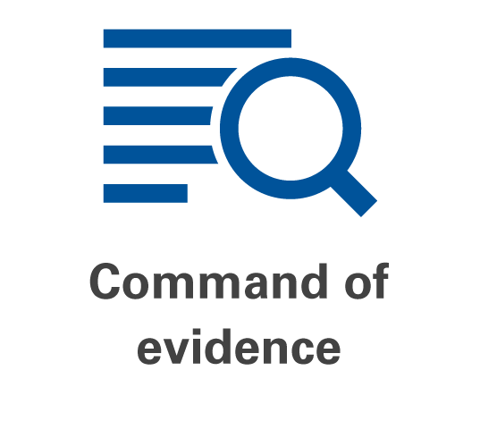
8 Key Changes to the SAT
Students will be asked to:
Interpret, synthesize, and use evidence found in a wide range of sources
Support the answers they choose
Integrate information conveyed through both reading passages and informational graphics
Notes:
Command of Evidence
When students take the Evidence-Based Reading and Writing section of the redesigned SAT, they’ll be asked to demonstrate their ability to interpret, synthesize, and use evidence found in a wide range of sources. These include informational graphics and multiparagraph passages excerpted from literature and literary nonfiction; texts in the humanities, science, history, and social studies; and career-related sources.
For every passage students read, there will be at least one question asking them to select a quote from the text that best supports the answer they have chosen in response to the preceding question. Some passages will be paired with informational graphics, and students will be asked to integrate the information conveyed through each in order to find the best answer.
Questions that assess writing skills will also depend on a command of evidence. Students will be asked to analyze sequences of paragraphs to make sure they are correct, grammatically and substantively. In some questions, students will be asked to interpret graphics and edit the accompanying passages so that they accurately convey the information in the graphics.
The redesigned SAT will more closely reflect the real work of college and career, where a flexible command of evidence — whether found in text or graphic — is more important than ever.

Slide 14
Current SAT Example: Critical Reading
Based on information presented in the passage, which best describes what Georgia was “tired of ” (line 8) ?
(A) Being forced to earn a living
(B) Being teased about Joseph Tank
(C) Being considered a hack writer by some of her colleagues
(D) Being betrayed by her supposed friends
(E) Being the only woman in the newsroom
Notes:
The passage is not shown here, but the point is that we ask multiple choice questions to understand reading comprehension. There is no follow up question that asks for evidence.

Slide 15
Redesigned SAT Sample Item: Command of Evidence (Reading Test)
Notes:
Some questions may look very much like the questions on the current SAT: i.e., testing reading comprehension through asking questions about the passage.
Entire passage does not appear on the slide, but it is important to note that the passage is an authentic text adapted from a speech delivered in 1974. The redesigned SAT will contain real world contexts – passages will be authentic texts and not constructed solely for the purpose of the SAT.

Slide 16
Redesigned SAT Sample Item: Command of Evidence (Reading Test) Continued
Notes:
This is a follow up question to the previous slide and demonstrates one way in which the redesigned SAT will test command of evidence.

Slide 17
Redesigned SAT Sample Item: Command of Evidence (Writing & Language Test)
Notes:
Entire passage not shown on this slide
Asks the student to use evidence (a graph) to identify whether the sentence is accurate or can be improved.
Sentence in question appears as part of a larger passage, including graphical information.

Slide 18
8 Key Changes to the SAT
The redesigned essay will:
More closely mirror college writing assignments
Cultivate close reading, careful analysis, and clear writing
Promote the practice of reading a wide variety of arguments and analyzing an author’s work
Notes:
Essay Analyzing a Source
The focus of the Essay section on the redesigned SAT will be very different from the essay on the current SAT. Students will read a passage and explain how the author builds an argument. They’ll need to support their claims with evidence from the passage. This task more closely mirrors college writing assignments.
The new Essay section is designed to support high school students and teachers as they cultivate close reading, careful analysis, and clear writing. It will promote the practice of reading a wide variety of arguments and analyzing how authors do their work as writers.
The essay prompt will be shared in advance and remain consistent. Only the source material (passage) will change. The Essay will be an optional component of the SAT, although some school districts and colleges will require it.

Slide 19
Current SAT Example: Essay
Think carefully about the issue presented in the following excerpt and the assignment below.
Some see printed books as dusty remnants from the preelectronic age. They point out that electronic books, or e-books, cost less to produce than printed books and that producing them has a much smaller impact on natural resources such as trees. Yet why should printed books be considered obsolete or outdated just because there is something cheaper and more modern? With books, as with many other things, just because a new version has its merits doesn’t mean that the older version should be eliminated.
Assignment:
Should we hold on to the old when innovations are available, or should we simply move forward? Plan and write an essay in which you develop your point of view on this issue. Support your position with reasoning and examples taken from your reading, studies, experience, or observations.
Notes:
Asks for student point of view/position
No source document
Prompt unknown until test day
Examples can be made up

Slide 20
Redesigned SAT Essay Prompt
1
2
[Sample Passage here]
(In this example , passage is adapted from “Why Literature Matters” by Dana Gioia. ©2005 by The New York Times Company. Originally published April 10, 2005.)
3
Notes:
Common prompt: publicly available
Represents sound instructional model
Sources are arguments written for a broad audience
Emphasis on analysis of the argument (not opinion)
Expanded time for students to read, plan, write (50 minutes)
Analytic scoring

Slide 21
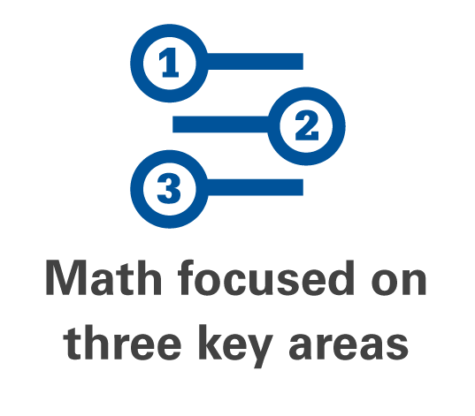
8 Key Changes to the SAT
Current research shows that three key areas most contribute to readiness for college and career training:
Problem Solving and Data Analysis (quantitative literacy)
Heart of Algebra (mastery of linear equations)
Passport to Advanced Math (familiarity with more complex equations)
Notes:
Math Focused on Three Key Areas
The exam will focus in depth on three essential areas of math: Problem Solving and Data Analysis, the Heart of Algebra, and Passport to Advanced Math. Problem Solving and Data Analysis is about being quantitatively literate. It includes using ratios, percentages, and proportional reasoning to solve problems in science, social science, and career contexts. The Heart of Algebra focuses on the mastery of linear equations and systems, which helps students develop key powers of abstraction. Passport to Advanced Math focuses on the student’s familiarity with more complex equations and the manipulation they require.
Current research shows that these areas most contribute to readiness for college and career training. They’re used disproportionately in a wide range of majors and careers. The SAT will sample from additional topics in math, but keep a strong focus on these three.

Slide 22
Current SAT Example: Math
Notes:
This question presents the student with a reasoning puzzle unrelated to the school mathematics curriculum. Being able to solve unfamiliar problems is valuable, but a test based entirely on this idea does not provide as much assurance that students have learned essential math skills and practices — nor does it reward students for their
hard work in doing so.

Slide 23
Redesigned SAT Sample Item: Math
Notes:
sample from the Heart of Algebra category
questions require reasoning and insight as they relate to important curricular skills such as looking for and making use of algebraic structure

Slide 24
Redesigned SAT Sample Item: Math
Notes:
This is a rich application item that uses a science context to make a connection across math domains (functions and statistics) and across subjects (math and science).

Slide 25
8 Key Changes to the SAT
Students will engage with questions that:
Directly relate to the work performed in college and career
Include charts, graphs, and passages likely to be encountered in science, social science, and other majors and careers
Feature multistep applications to solve problems in science, social science, career scenarios, and other real-life contexts
Notes:
Problems Grounded in Real-World Contexts
Throughout the redesigned SAT, students will engage with questions grounded in the real world, questions directly related to the work performed in college and career.
In the Evidence-Based Reading and Writing section, reading questions will include literature and literary nonfiction, but also feature charts, graphs, and passages like the ones students are likely to encounter in science, social science, and other majors and careers. Students will be asked to do more than correct errors; they’ll edit and revise to improve texts from the humanities, history, social science, and career contexts.
Students will engage with questions that:
Directly relate to the work performed in college and career
Include charts, graphs, and passages likely to be encountered in science, social science, and other majors and careers
Feature multistep applications to solve problems in science, social science, career scenarios, and other real-life contexts
The Math section will feature multistep applications to solve problems in science, social science, career scenarios, and other real-life contexts. Students will be presented with a scenario and then asked several questions about it. This allows students to dig into a situation and think about it, then model it mathematically.

Slide 26
8 Key Changes to the SAT
Students will apply their reading, writing, language, and math skills to answer questions in science, history, and social studies contexts.
Notes:
Analysis in Science and in Social Studies
When students take the redesigned SAT, they will be asked to apply their reading, writing, language, and math skills to answer questions in science, history, and social studies contexts. They will use these skills — in college, in their jobs, and in their lives — to make sense of recent discoveries, political developments, global events, and health and environmental issues.
Students will encounter challenging texts and informational graphics that pertain to issues and topics like these in the Evidence-Based Reading and Writing section and the Math section. Questions will require them to read and comprehend texts, revise texts to be consistent with data presented in graphics, synthesize information presented through texts and graphics, and solve problems based in science and social science.

Slide 27
8 Key Changes to the SAT
The redesigned SAT will include one of the following:
An excerpt from one of the Founding Documents
A text from the ongoing Great Global Conversation about freedom, justice, and human dignity
No prior knowledge of the text will be required.
Notes:
Founding Documents and Great Global Conversation
America’s founding documents — such as the Declaration of Independence, the Constitution, and the Bill of Rights — are all rather short, but they have inspired a conversation that endures today. Every time students take the redesigned SAT, they will encounter an excerpt from one of the Founding Documents or a text from the ongoing Great Global Conversation about freedom, justice, and human dignity. In this way, we hope that the redesigned SAT will inspire deep engagement with texts that matter and reflect not only what is important for college and career, but what is important for citizenship here and around the world.

Slide 28
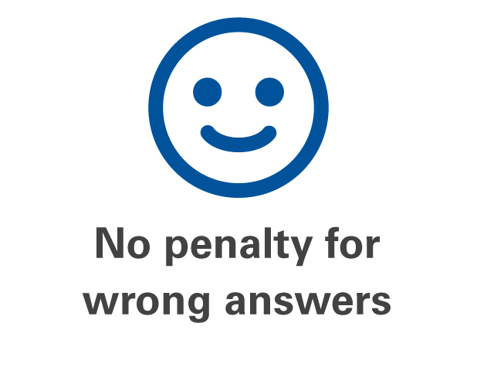
8 Key Changes to the SAT
One point for each correct answer
Zero points for unanswered items
Zero points for wrong answers
Notes:
No Penalty for Wrong Answers
The redesigned SAT will remove the penalty for wrong answers. Students will earn points for the questions they answer correctly. This move to rights-only scoring encourages students to give the best answer they have to every problem.

Slide 29
Redesigned PSAT/NMSQT

Slide 30
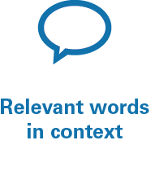
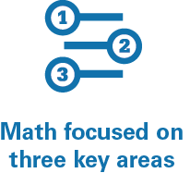
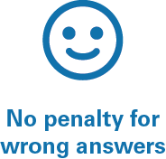
Connection to the Redesigned SAT
The redesigned PSAT/NMSQT will mirror the knowledge and skill areas tested by the redesigned SAT.
The 7 key changes of the redesigned PSAT/NMSQT are:

Slide 31
About the Redesigned PSAT/NMSQT
The first administration of the redesigned PSAT/NMSQT will be in fall 2015.
Sample questions to help students prepare will be available in December 2014/January 2015.
A full practice test will be available in March 2015.

Slide 32
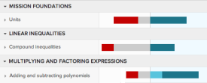
Khan Academy: Road to Success
Jeff’s Path to SAT Success
2
Personalized Learning Roadmap
1
Send Score Data
3
Official SAT Practice Tests
With Scoring for Paper & Pencil
Powered By Schools, Educators, Community Groups
Notes:
Send score data. Note that this is more than just the scores – it’s the full item-level metadata. Question 1 was a high difficulty geometry question and Johnny missed it. If student has not completed a CB exam, or chooses not to share scores, KA will administer a diagnostic.
Personalized Roadmap. This is constantly evolving and based on student results, progress, and new learnings that KA will have from other students.
Practice tests (with scoring). CB is writing practice tests for the Khan Academy platform, written by the same team that is writing the operational exam. Students will be able to take these practice tests online, or in paper and pencil format (through downloading/printing PDFs, or the published retail book). If they take paper and pencil tests they’ll be able to take a picture of the grid through a smartphone app we’re building which will give them an immediate score and integrate the results into their KA profile, feeding further adaptation and personalization.

Slide 33
$180 Million in Increased Scholarship Connections

Slide 34
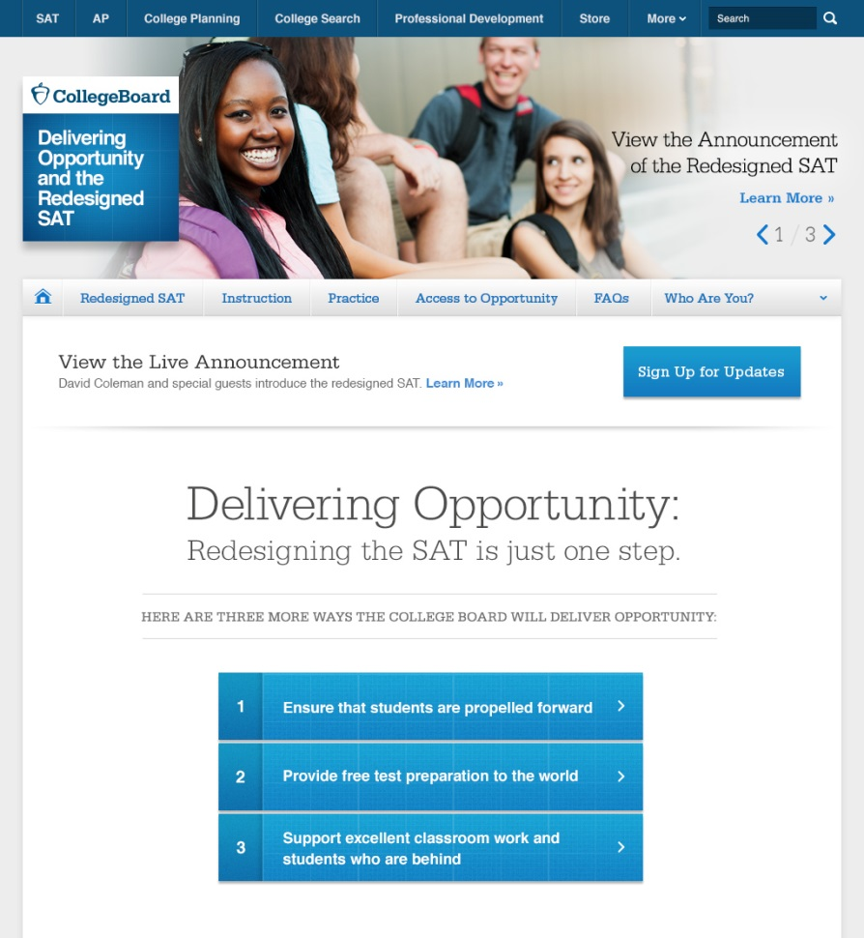
For More Information
Sign up for updates:
www.deliveringopportunity.org

