Slide 1
How do we evaluate an argument for effectiveness?
The goal of argumentative writing is to persuade your audience that your ideas are valid, or more valid than someone else's.
Appeals
Types of Evidence
Fallacies

Slide 2
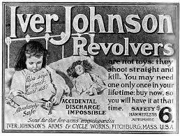
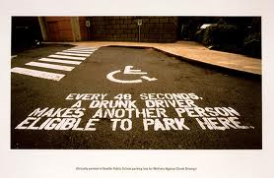
The 3 Appeals
Ethos (Credibility) = means convincing by the character of the author. We tend to believe people whom we respect.
the source's credibility, the speaker's/author's authority
Pathos (Emotional) means persuading by appealing to the reader's emotions.
the emotional or motivational appeals; vivid language, emotional language and numerous sensory details.
How does Novant Health use Michael Jordan as a way to create credibility?
How does this gun ad appeal to our emotions? What leverage does it use?
Logos (Logical) means persuading by the use of
reasoning.
the logic used to support a claim can also
be the facts and statistics used to help support
the argument.
What logical tool
does this ad employ?

Slide 3
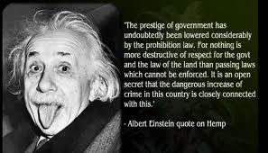
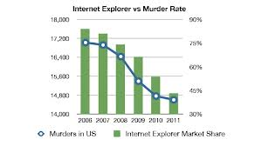
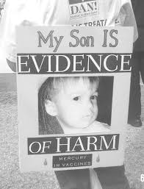
3 Types of Evidence
Logical
Using facts and quotes are a powerful means of convincing. Facts/quotes can come from your reading, observation, or personal experience. Facts cannot be disputed. This makes them a strong form of evidence.
Empirical
Using statistics can provide excellent support for your argument. Arguments employing amounts and numbers are concrete; and therefore, support claims
Anecdotal
Using examples or anecdotes from your own experience can enhance your meaning and also engage the reader. Personal examples make your ideas concrete. These real-life examples allow a reader to relate to the issues personally.

Slide 4
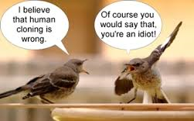
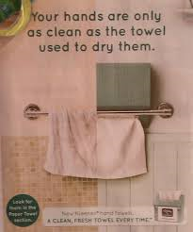
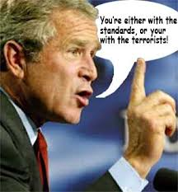
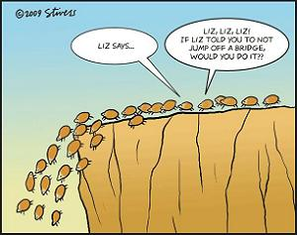
The Fallacies
Slippery slope: This is a conclusion based on the premise that if A happens, then eventually through a series of small steps, through B, C,..., X, Y, Z will happen, too.
Either/or: This is a conclusion that oversimplifies the argument by reducing it to only two sides or choices
Ad hominem: This is an attack on the character of a person rather than their opinions or arguments
Ad populum: A claim based on the majorities opinion. If many believe so, it is so.

