Slide 1
11th GRADE - Grade Level

Slide 2
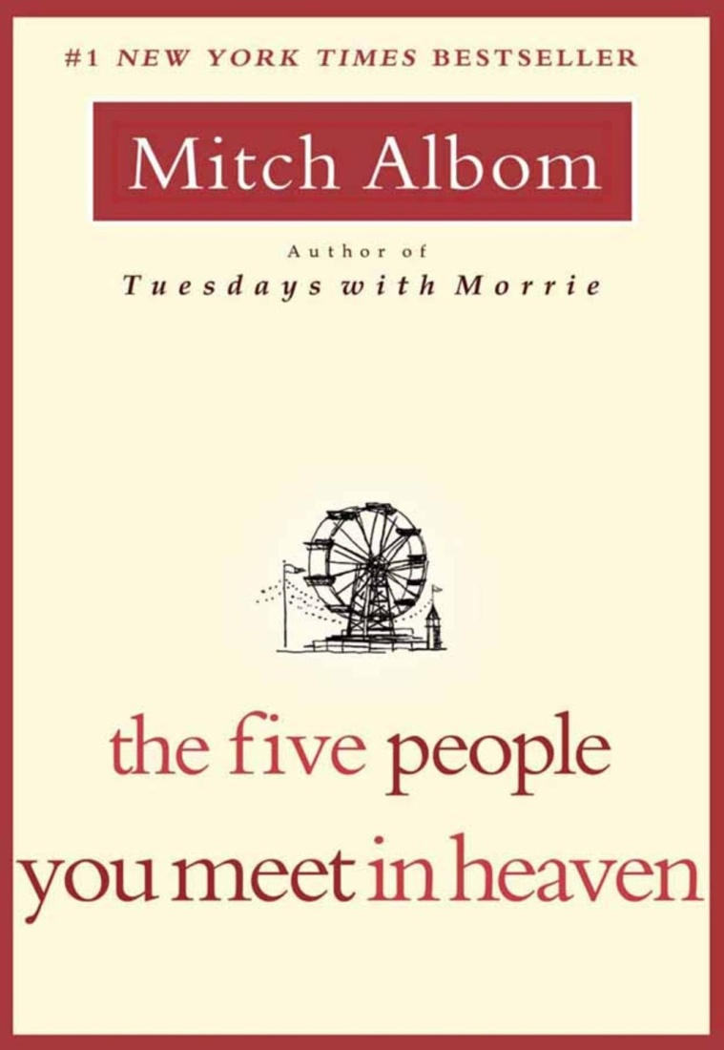
Five People You Meet in Heaven by Mitch Albom
A bitter eighty-three-year-old war veteran who believes his life is meaningless dies while trying to save a little girl's life and finds himself in heaven, where five people from his past--some loved ones, some strangers--explain what his years on Earth really meant, and whether or not he succeeded in saving the child.

Slide 3
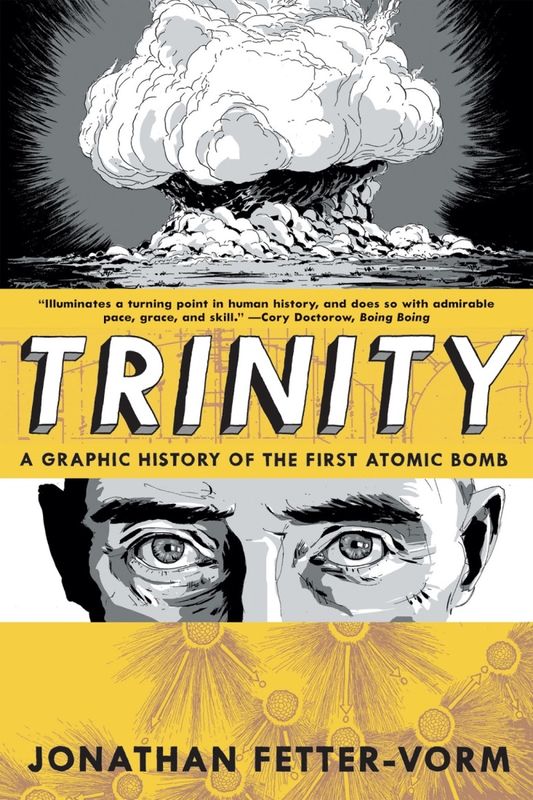
Trinity: Graphic Hist. of the First Atomic Bomb by Fetter-Vorm
Presents the history of the development of the first atomic bomb, from experiments with nuclear fusion during the 19th century through the Manhattan Project.
Additionally, describes the destruction caused by the bomb in Japan, and the tensions over nuclear weapons that have kept the world on edge ever since.

Slide 4
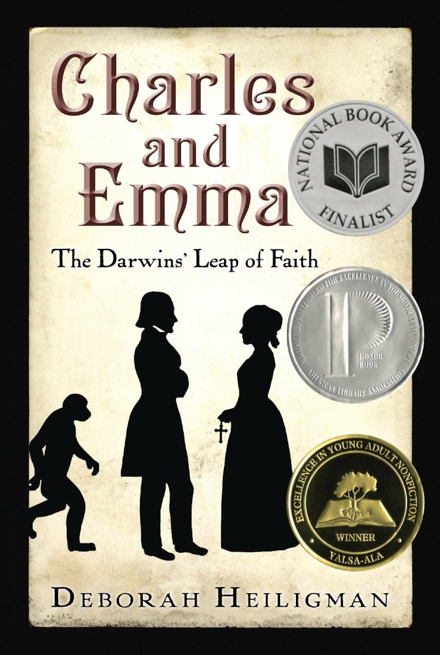
Charles and Emma by Deborah Heiligman
A thought-provoking account of Charles Darwin, the man behind evolutionary theory: how his personal life affected his work and vice versa.

Slide 5
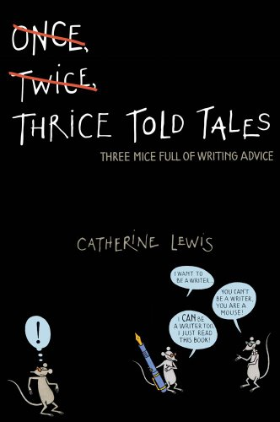
Thrice Told Tales by Catherine Lewis
Can one nursery rhyme explain the secrets of the universe? Well, not exactly—but it can help you understand the difference between bildungsroman, epigram, and epistolary.
This book will teach you how to fine tune your own writing, bildungsroman and all.

Slide 6
Never Fall Down by Patricia McCormick
When soldiers arrive in his hometown in Cambodia, Arn Chorn-Pond is separated from his family and sent to a labor camp, where he works in the rice paddies until he volunteers to learn to play an instrument--a decision that both saves his life and lands him in battle. Based on a true story.

Slide 7
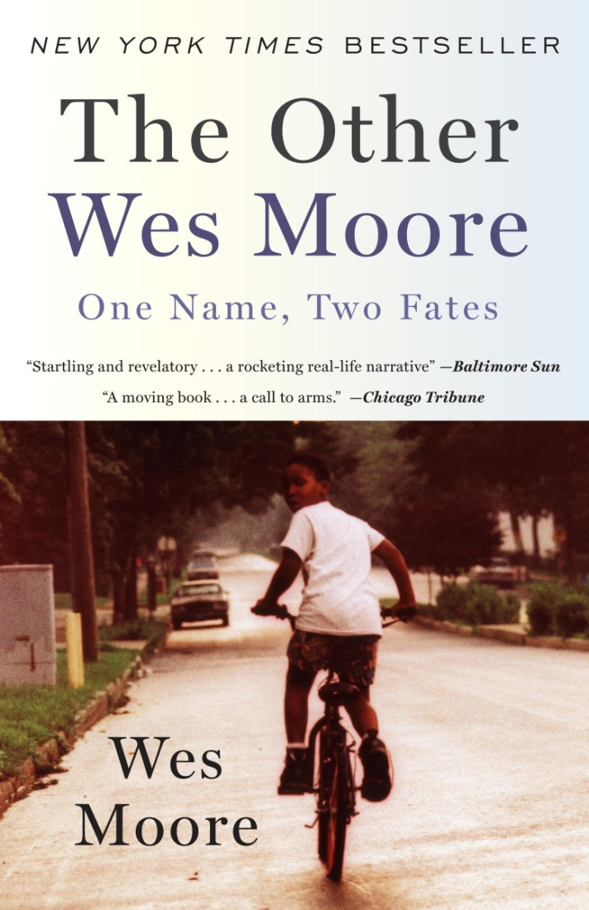
The Other Wes Moore by Wes Moore/T. Smiley
Two kids with the same name lived in the same decaying city. One went on to be a Rhodes Scholar, decorated combat veteran, White House Fellow, and business leader. The other is serving a life sentence in prison.
What led to their different paths?

Slide 8
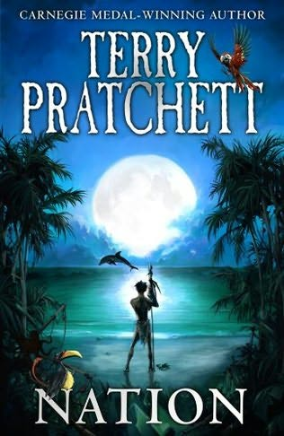
Nation by Terry Pratchett
A tsunami wipes out all but one boy on an island nation.
Daphne washes ashore from a shipwrecked boat and the two eventually become friends.
More survivors arrive and they must fight to rebuild their lives.
An alternate history with fantasy elements.

Slide 9
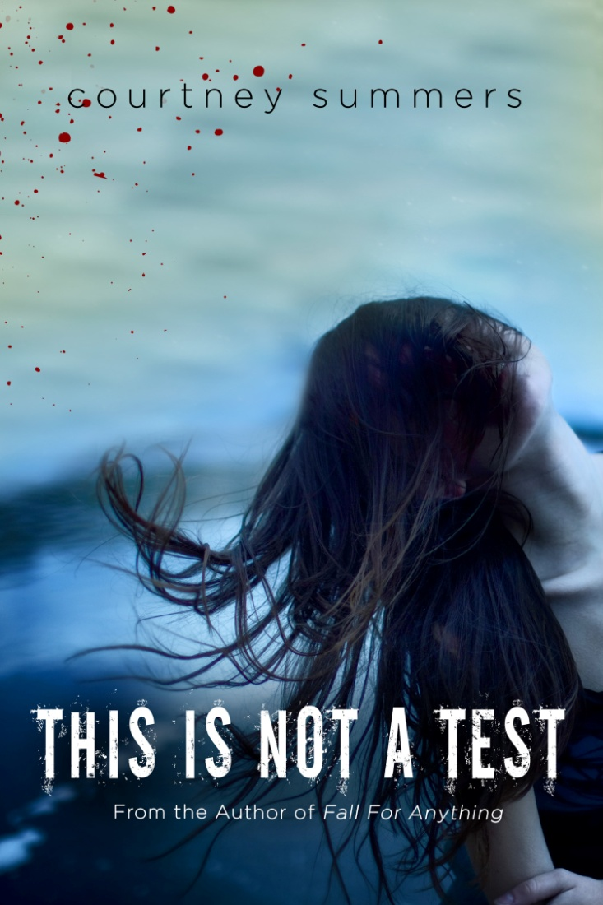
This is Not a Test by Courtney Summers
Barricaded in Cortege High with five other teens while zombies try to get in, Sloane Price observes her fellow captives become more unpredictable and violent as time passes although they each have much more reason to live than she has.

Slide 10
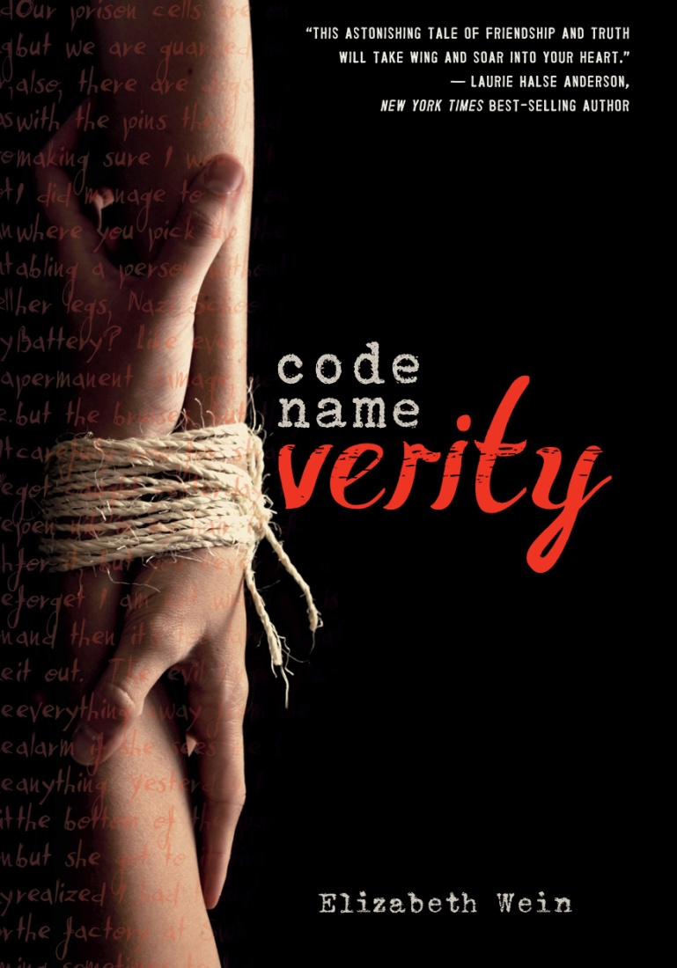
Code Name Verity by Elizabeth Wein
In 1943, a British fighter plane crashes in Nazi-occupied France and the survivor tells a tale of friendship, war, espionage, and great courage as she relates what she must to survive while keeping secret all that she can.
A gut-wrenching, first-person mystery.

Slide 11
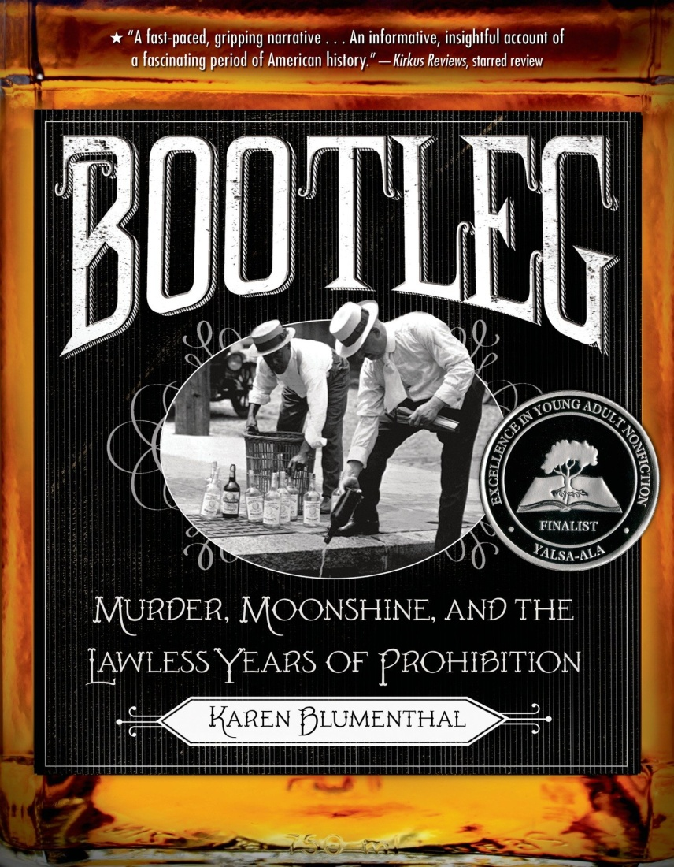
Bootleg : Murder, Moonshine, and the Lawless Years of Prohibition by Karen Blumenthal
Read about how the “grand social revolution that was supposed to forever end drunkenness, reduce crime, and make life better for America’s families” did almost precisely the opposite.

Slide 12
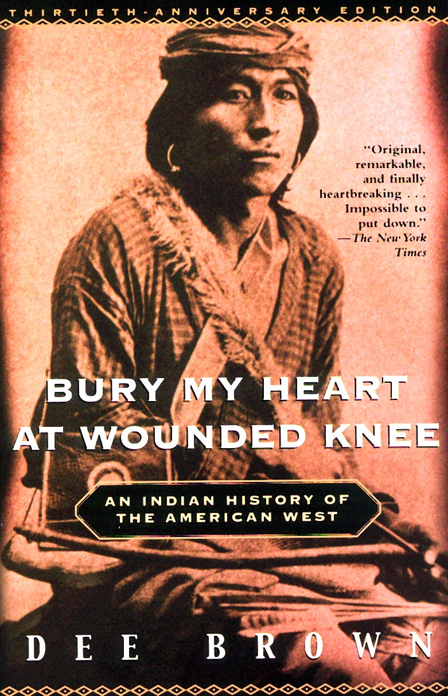
Bury My Heart At Wounded Knee by Dee Brown
This is a classic, eloquent, meticulously documented account of the systematic destruction of the American Indian during the second half of the nineteenth century.
A unique and disturbing narrative told with force and clarity.

Slide 13
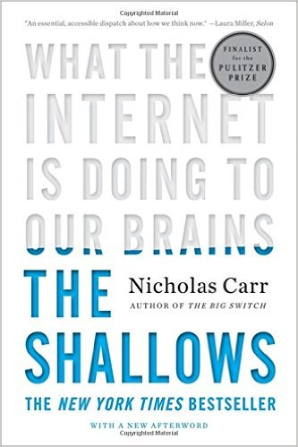
The Shallows by Nicholas Carr
"Is Google making us stupid?” is the question the author tries to answer with this book.
He argues that human focus and patience have become shorter, deep thought has lessened, and reading has turned into scanning due to changes the Internet usage causes on neural pathways.

Slide 14
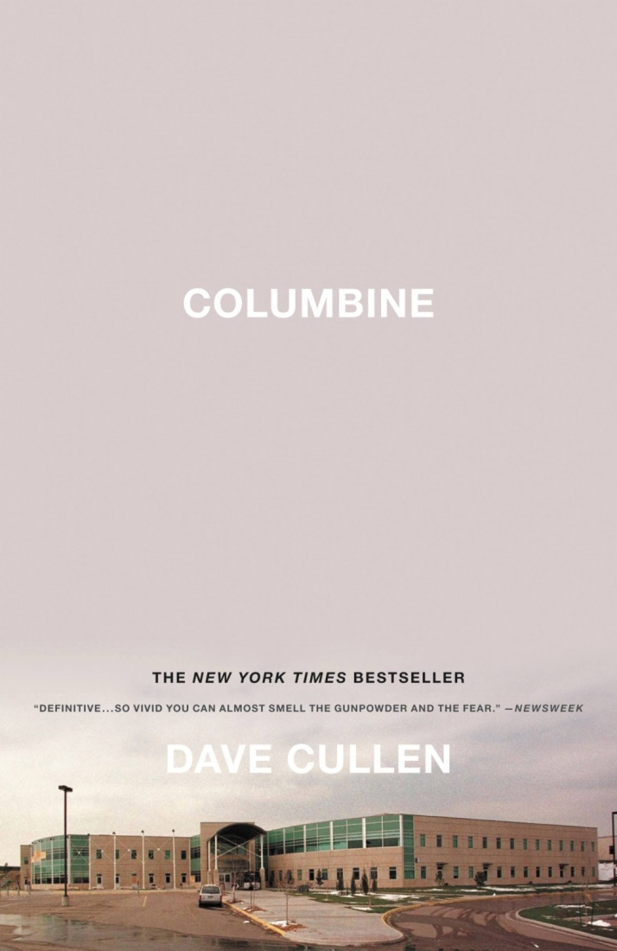
Columbine by David Cullen
An account of the shootings at Colorado's Columbine High School on April 20, 1999, focusing on the teenage killers Eric Harris and Dylan Klebold, drawing from interviews, police files, psychological studies, and writings and tapes by the boys to look at the signs they left that disaster was looming.

Slide 15
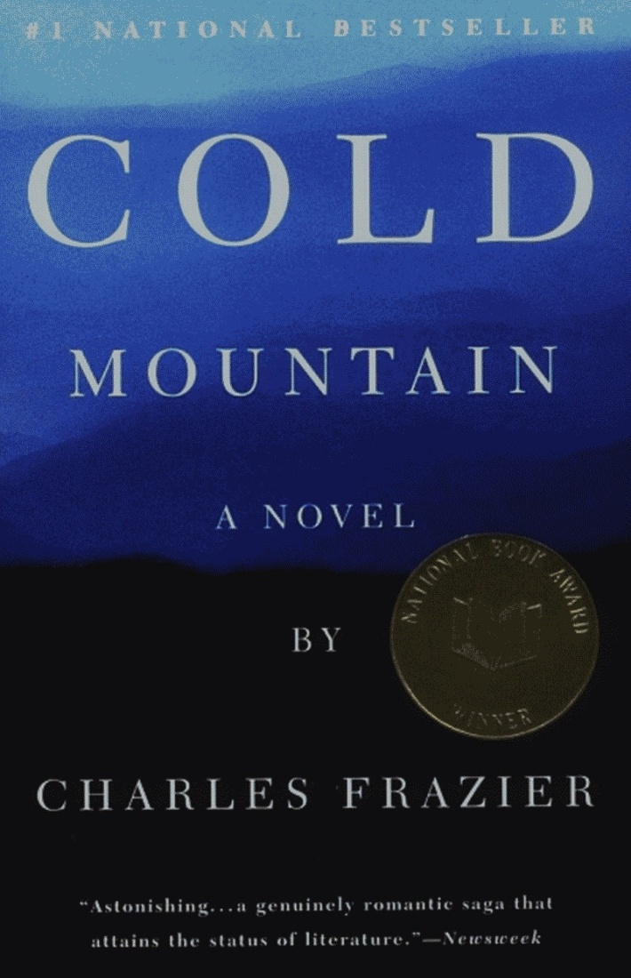
Cold Mountain by Charles Frazier
Inman, a wounded Confederate soldier, leaves the hospital where he is being treated and determines to walk home to his sweetheart Ada, only to find the land and the girl he remembers are as changed by the war as he is.

Slide 16
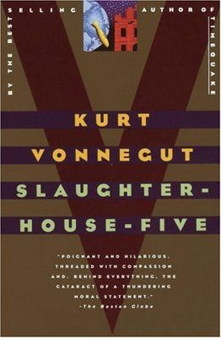
Slaughterhouse-Five by Kurt Vonnegut
Billy Pilgrim, the novel’s protagonist, has become “unstuck in time.” He travels between periods of his life, unable to control which period he lands in. So the narrative is not chronological - it jumps back and forth in time and place, from Dresden in WWII to his time in an alien zoo exhibit on humans.
Elements of historical, biographical and science fiction mix here.

